Slide 1
How to use this resource
This resource, comprising slide deck and accompanying presenter's script, provides a generic introduction to the IFRS Sustainability Disclosure Standards.
It is made available for general use by third parties to help promote broader awareness and understanding of the Standards.
The deck may be used in presentations under the user’s brand.
The resource may not be used for any commercial purpose.

Slide 2
Introducing the ISSB Standards: better information for better decisions
This presentation contains copyright material of the IFRS Foundation in respect of which all rights are reserved. This material is included in this presentation with the permission of the IFRS Foundation. No permission is granted to third parties to reproduce or distribute. For full access to IFRS Standards and the work of the IFRS Foundation please visit http://www.ifrs.org. The IFRS Foundation, the authors and the publishers do not accept responsibility for any loss caused by acting or refraining from acting in reliance on the material in this presentation, whether such loss is caused by negligence or otherwise.

Slide 3
Overview
1. Introduction
2. IFRS S1 – General requirements
3. IFRS S2 – Climate
4. Conclusion
Notes:
Good [morning/afternoon], everyone.
Welcome to today's presentation on the IFRS Foundation and its International Sustainability Standards Board – the ISSB. During this presentation we will cover key aspects of the ISSB's inaugural standards - IFRS S1, which provides general requirements and IFRS S2, which is focused on climate.

Slide 4
4
Structure
Public accountability
IFRS Foundation Monitoring Board
Governance, strategy, oversight
IFRS Foundation Trustees
Independent standard-setting
International Accounting Standards Board (IASB)
International Sustainability Standards Board (ISSB)
IFRS Interpretations Committee
Notes:
Let's begin with a brief introduction to the IFRS Foundation.
First, let’s go over the structure of the IFRS Foundation and its two standard-setting boards.
The IFRS Foundation is a not-for-profit organisation founded in 2001 on the belief that better information supports better economic and investment decisions.
The IFRS Foundation's mission is to develop IFRS Standards that bring transparency, accountability and efficiency to capital markets around the world. The IFRS Foundation's work serves the public interest by fostering trust, growth and long-term financial stability in the global economy.
The IFRS Foundation’s founding principle is that better information leads to better decisions. IFRS Standards meet this need by enabling companies worldwide to provide such information to their investors.
The IFRS Foundation oversees the development and governance of international accounting and sustainability-related Standards and operates under a three-tier governance model.
The first tier is the Monitoring Board, a group of capital market authorities responsible for setting out the form and content of financial reporting in their jurisdictions. It reinforces the public oversight of the Foundation and the Trustees.
The next tier is the Trustees, who are appointed from various countries and professional backgrounds. They are responsible for governance and organisational strategy and provide strategic oversight for the standard-setting boards.
And then, the two standard-setting boards.
The International Accounting Standards Board, or IASB, was formed in 2001 to replace the International Accounting Standards Committee (IASC), which was set up in 1973. IASB members are responsible for the development and publication of IFRS Accounting Standards. The IFRS Interpretations Committee works with the IASB to support consistent application of IFRS Accounting Standards by responding to stakeholders’ application questions.
The International Sustainability Standards Board, or ISSB, was established in 2021 at COP26 in Glasgow. The ISSB is an independent sustainability disclosure standard-setting body of the IFRS Foundation. Its 14 members are appointed from various countries and professional backgrounds, including academia, accountancy, investment, sustainability, market or financial regulation and reporting companies. The ISSB issues IFRS Sustainability Disclosure Standards and the IFRS Sustainability Disclosure Taxonomy, which enables digital reporting. The ISSB also maintains the SASB Standards.
Both boards work independently yet complementarily to provide investors and capital providers with comprehensive information.

Slide 5
Strong market demand
The ISSB was established as part of the IFRS Foundation because of investor, company and international policy maker (including the G20, G7, IOSCO and the Financial Stability Board) demand for:
decision-useful, comparable information
ending the ‘alphabet soup’ of voluntary initiatives
an efficient reporting landscape
The ISSB has a transparent, rigorous due process to develop market-informed Standards that respond to these needs
Notes:
Let's look at why the ISSB was established.
While sustainability reporting has been around for a while, there were specific circumstances that led to the demand for the ISSB.
Around the world, sustainability factors are becoming – if they are not already – a mainstream part of investment decision-making.
These factors are also increasingly central to how companies plan, manage and report.
Investors need decision-useful, consistent, comparable information that enables them to understand sustainability-related risks and opportunities.
Information has been provided, but not in a consistent manner - and it has been designed to meet different audiences. There has been confusion around the myriad standards and frameworks, with companies and investors seeking clarity and guidance.
This confusion adds costs and complexity for companies and for the capital markets, which rely on robust information to function efficiently.
By consolidating and inheriting the resources of other investor-focused reporting initiatives, the ISSB has been able to address fragmentation and align international support for a global baseline of sustainability disclosures - for example from the G7, the G20 and the Financial Stability Board.
Furthermore, the ISSB has a transparent, rigorous due process to develop market-informed Standards that respond to these needs.
Jurisdictions around the world are taking steps to adopt or otherwise use the ISSB Standards.

Slide 6
ISSB Standards enhance investor-company dialogue
Decision-useful
Cost-effective
Developing globally comparable sustainability-related disclosures - that are assurable - to meet the information needs of investors
Enabling companies to communicate to investors globally comparable, comprehensive information about sustainability-related risks and opportunities
Notes:
So why were the ISSB Standards developed?
The ISSB Standards are designed to enhance the dialogue between investors and companies, helping companies communicate sustainability-related risks and opportunities to investors effectively.
The ISSB focused on making sure the Standards elicit decision-useful information from companies for investors. Disclosures that are assurable, globally comparable, and meet investor information needs.
The ISSB also focused on ensuring the Standards are cost effective, enabling companies to communicate comprehensively about their sustainability-related risks and opportunities.

Slide 7
Rationalising investor-focused standards and frameworks
TCFD recommendations
Notes:
The ISSB has not reinvented the wheel. It has consolidated the global sustainability disclosure landscape, reducing complexity and building on the expertise and practices from established investor-focused frameworks and standards. This consolidation helps those already familiar with these materials to apply ISSB Standards effectively.
The creation of the ISSB involved the consolidation of the Climate Disclosure Standards Board (CDSB) and the Value Reporting Foundation (VRF), which governed materials from the Sustainability Accounting Standards Board (SASB) and the International Integrated Reporting Council (IIRC). The Task Force on Climate-related Financial Disclosure (TCFD) was disbanded following the publication of the ISSB's inaugural standards.
IFRS S1 and IFRS S2 fully incorporate the recommendations of the TCFD and build on and consolidate materials from the Integrated Reporting Framework, SASB Standards and CDSB guidance.

Slide 8
A truly global baseline of disclosures
can be added to meet jurisdiction-specific requirements
can be added to meet broader multi-stakeholder needs
additional
building blocks
ISSB Standards
provide a comprehensive foundation of disclosures for global jurisdictional adoption
are a common language for comparable, decision-useful disclosures
are designed to meet investor needs across global capital markets
Notes:
The ISSB's role is to provide a comprehensive global baseline of sustainability-related disclosures through its Standards.
The ISSB develops standards that can provide a common language for sustainability information, to enable comparable and consistent sustainability disclosures across global capital markets. The ISSB works with jurisdictions around the world, as well as its stakeholders, to deliver this.
The ISSB’s global baseline has been developed to provide the information that is material to investors globally.
Jurisdictions are then able to require local market participants to disclose further information, by adding their own additional ‘building blocks’ to these global foundations, tailored to the incremental information needs that a jurisdiction considers necessary. Additional disclosures can be required, as long as such information is presented in a way that does not obscure the global baseline.
Companies may also decide to use additional standards voluntarily – such as the GRI Standards.
These building blocks could be focused on disclosures that go beyond the remit of the ISSB, which is to meet the information needs of investors and capital markets. Or they could include jurisdiction-specific information relevant to investors.
Taking this building block approach provides an efficient reporting system for the benefit of companies.

Slide 9
Making ISSB Standards the global baseline
Audit standard-setters
Market participants
ISSB
IOSCO
Jurisdictions
provide comprehensive global baseline through Standards
endorses the ISSB Standards recommending adoption
enhance and develop assurance standards
require by adopting the Standards
voluntarily opt to apply the Standards
Notes:
There are several important aspects that contribute to making the ISSB Standards the global baseline of sustainability-related disclosures.
The ISSB’s role is to provide a comprehensive global baseline of sustainability-related disclosures through Standards.
IOSCO is made up of securities commissions from around the world. As such it is the global body for securities markets regulation. It has independently assessed the ISSB Standards and recommends them to jurisdictions for adoption.
IOSCO’s endorsement sends a strong signal to jurisdictions around the world that the ISSB Standards are fit for purpose for capital market use. This enables pricing in of sustainability-related risks and opportunities, and facilitates enhanced data collection and analysis.
IOSCO is calling on its 130 member jurisdictions—capital markets authorities that regulate more than 95% of the world’s securities markets—to consider how they can incorporate the ISSB Standards into their respective regulatory frameworks to deliver consistency and comparability of sustainability-related disclosures worldwide.
Next there are the audit standard setters, such as the International Auditing and Assurance Standards Board, or IAASB, which is in the process of setting sustainability-related assurance standards to help drive confidence and trust in disclosures.
And then you have the jurisdictions that will require the Standards, and those companies that will opt to apply them voluntarily because of the perceived benefits.
All of these elements are critical to ensuring the global baseline is effective.

Slide 10
IFRS S1: General Requirements for Disclosure of Sustainability-related Financial Information
Notes:
Next, I'll provide an overview of the ISSB's foundational standard: IFRS S1 General Requirements for Disclosure of Sustainability-related Financial Information.

Slide 11
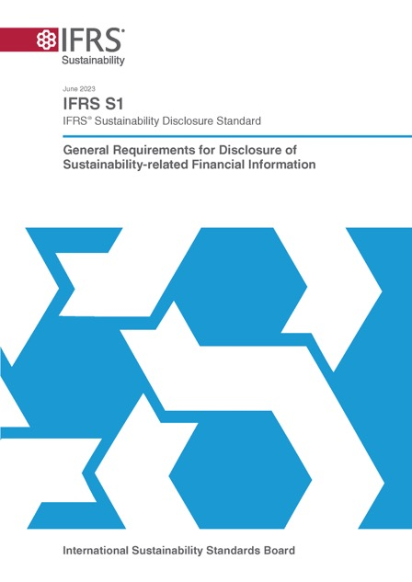
IFRS S1: General Requirements for Disclosure of Sustainability-related Financial Information
Asks for disclosure of material information about sustainability-related risks and opportunities with the financial statements, to meet investor information needs
Applies TCFD architecture whenever providing information about sustainability
Requires industry-specific disclosures
For matters other than climate (IFRS S2) refers to sources to help companies identify sustainability-related risks and opportunities and information
Can be used in conjunction with any accounting requirements (GAAP)
Notes:
This slide sets out key concepts in IFRS S1, the ISSB's overarching and foundational standard.
IFRS S1 sets out the overarching requirement for a company to disclose information about its sustainability-related risks and opportunities that is useful to investors in making decisions relating to providing resources to the company.
Here, we mean those risks and opportunities that investors would be interested in. We do not mean every single risk and opportunity that a company could be affected by.
IFRS S1 describes this objective by referring to risks and opportunities that could reasonably be expected to affect a company’s prospects. That is its cash flows, its access to finance or cost of capital over the short, medium or long term.
To make sure it is connected and can be considered alongside financial statements, the information is disclosed as part of a company’s general purpose financial reports.
IFRS S1 sets out general requirements for the content and presentation of information. These include the core content for a complete set of sustainability-related financial disclosures, establishing a comprehensive baseline of sustainability-related financial information to meet the needs of global capital markets.
The Standard applies the TCFD architecture whenever providing information about sustainability - a structure already used by the many companies around the world that use the TCFD recommendations.
IFRS S1 requires industry-specific disclosures so that companies can focus on reporting that better describes their business.
For matters other than climate, which is addressed in IFRS S2, IFRS S1 refers to sources to help companies identify sustainability-related risks and opportunities and information - for example, the SASB Standards.
IFRS S1 can be used in conjunction with any generally accepted accounting principles, or GAAP. It also benefits from having been designed using concepts from the IFRS Accounting Standards to help build connection with the financial statements and to deliver a holistic reporting package.

Slide 12
How sustainability can affect a company’s prospects
A company’s ability to deliver financial value for investors is inextricably linked to:
Natural environment
Stakeholders
Society
Economy
Builds on concepts from the Integrated Reporting Framework
Notes:
It’s important that we be clear about why sustainability-related information matters to investors.
IFRS S1 explains that information about sustainability‑related risks and opportunities is useful to investors because a company’s ability to generate cash flows over the short, medium and long term is inextricably linked to the interactions between the company and its stakeholders, society, the economy and the natural environment throughout the company’s value chain.
Together, a company and the resources and relationships throughout its value chain form an interdependent system in which the company operates. The company’s dependencies and impacts on those resources and relationships give rise to its sustainability-related risks and opportunities.
IFRS S1 builds on the Integrated Reporting Framework concepts, which help companies articulate how they rely on, use and affect different types of resources and relationships - such as financial, social, human, and natural capital - to create, preserve or erode value for investors over time.

Slide 13
How companies identify material sustainability information
Information is material if omitting, misstating or obscuring it could reasonably be expected to influence investor decisions.
This is based on the IFRS Accounting Standards definition of ‘material’
Notes:
Next, I'll cover how IFRS S1 talks about material information.
A company will need to identify the sustainability-related risks and opportunities that could reasonably affect its prospects.
The information provided by a company on those risks and opportunities is information which meets the decision-making needs of investors. So IFRS S1 specifically requires the disclosure of material information about sustainability-related risks and opportunities that could reasonably be expected to affect an entity’s prospects.
The definition of material information used in IFRS S1 is based on and aligned with the definition found in the IFRS Accounting Standards. It is information that if omitted, misstated, or obscured by other information, could reasonably be expected to influence investor decisions.
In other words, the ISSB Standards seek to elicit disclosures from companies to enable the communication of key information that matters to investors.

Slide 14
Connected information
IFRS S1 asks for information that helps investors understand the connections between:
sustainability-related risks and opportunities
disclosures on core content
sustainability-related financial disclosures and financial statements
The disclosures are:
prepared for the same reporting entity and reporting period as the related financial statements
provided at the same time as the financial statements and as part of the general purpose financial reports
include data and assumptions that are consistent with the corresponding data and assumptions in the related financial statements, to the extent possible, considering accounting requirements.
Notes:
Next, let's look at what IFRS S1 says about connected information.
IFRS S1 requires a company to provide information that enables investors to understand connections.
This includes connections between various sustainability-related risks and opportunities. It includes connections within sustainability-related financial disclosures, such as those between the core content disclosure requirements on governance, strategy, risk management and metrics and targets - which we’ll come to shortly. It also includes connections across the sustainability-related financial disclosures and other parts of the company’s general purpose financial reports, including the financial statements.
To facilitate the understanding of such connections, IFRS S1 also requires that sustainability-related financial disclosures are prepared for the same reporting entity and for the same reporting period as the related financial statements. It further requires that these disclosures are provided at the same time as the financial statements and as part of the company’s general purpose financial reports - which also include the financial statements.
IFRS S1 requires a company to use data and assumptions in preparing its sustainability-related financial disclosures that are consistent—to the extent possible—with the corresponding data and assumptions used in preparing its related financial statements. A company would be required to disclose information on significant differences between the data and assumptions used.
IFRS S1 also requires a company to identify how sustainability‑related risks and opportunities have affected its financial position, financial performance and cash flows for the reporting period.
This is all designed to ensure that the package of information containing the financial statements and the sustainability information resulting from applying the ISSB Standards works well to inform investors.

Slide 15
Applies TCFD structure to set out core content areas
Applies TCFD structure to set out core content areas
Governance
Strategy
Risk management
Metrics and targets
Governance processes, controls and procedures a company uses to monitor, manage and oversee sustainability-related risks and opportunities
A company’s strategy for managing sustainability-related risks and opportunities
The process a company uses to identify, assess, prioritise and monitor sustainability-related risks and opportunities
A company's performance in relation to sustainability-related risks and opportunities
Notes:
IFRS S1 requires disclosures about governance, strategy, risk management, metrics and targets related to sustainability-related risks and opportunities. These core content areas are consistent with TCFD recommendations—extending the structure of the recommendations to sustainability‑related risks and opportunities beyond climate.
Governance covers information that enables investors to understand the governance processes, controls and procedures a company uses to monitor, manage and oversee sustainability‑related risks and opportunities.
Strategy covers information that enables investors to understand a company’s strategy for managing sustainability-related risks and opportunities.
Risk management covers information that enables investors to understand a company’s processes to identify, assess, prioritise and monitor sustainability‑related risks and opportunities.
Metrics and targets covers information that enables investors to understand a company’s performance in relation to its sustainability-related risks and opportunities. This includes progress towards any targets the company has set, or any targets it is required to meet by law or regulation.

Slide 16
Guidance for developing sustainability disclosures
Which risks & opportunities?
Which information?
To identify relevant risks and opportunities, a company uses ISSB Standards and shall consider:
SASB Standards
A company may also consider:
CDSB Framework Application Guidance
industry practice
materials of investor-focused standard setters
To identify what information to disclose, a company uses ISSB Standards, and for matters other than climate, shall consider:
SASB Standards
A company may also consider, to the extent it meets investor information needs:
CDSB Framework Application Guidance
industry practice
materials of investor-focused standard setters
GRI Standards
European Sustainability Reporting Standards
Notes:
IFRS S1 asks a company to provide material information on all sustainability risks and opportunities that could reasonably be expected to affect its prospects, whereas IFRS S2 sets out the requirements for climate-related disclosures.
So, what about risks and opportunities other than those relating to climate? IFRS S1 directs companies to sources of guidance which support the identification of risks and opportunities and disclosure of information about them.
First, when identifying which sustainability risks and opportunities to report on beyond climate, IFRS S1 says that consideration must be given to the SASB Standards. In addition, companies may consider other materials -specifically the CDSB Framework Application Guidance for Water- and Biodiversity-related Disclosures, industry practice, and materials of other investor-focused standard setters.
Then, after a company has identified the sustainability-related risks and opportunities to provide information about, IFRS S1 supports companies in identifying the information to disclose.
Here IFRS S1 says again a company must consider the SASB Standards. In addition, a company may consider, to the extent that it meets investors’ information needs, the aforementioned CDSB Framework Application Guidance, industry practice, materials of other investor-focused standard setters, as well as the GRI Standards and the European Sustainability Reporting Standards.
In summary, IFRS S1 provides guidance from day one, to facilitate reporting on all sustainability risks and opportunities that matter to investors.

Slide 17
IFRS S2: Climate-related Disclosures
Notes:
Now that I've covered the core content of IFRS S1, I'll move on to the ISSB's other Standard – IFRS S2 Climate-related Disclosures.

Slide 18
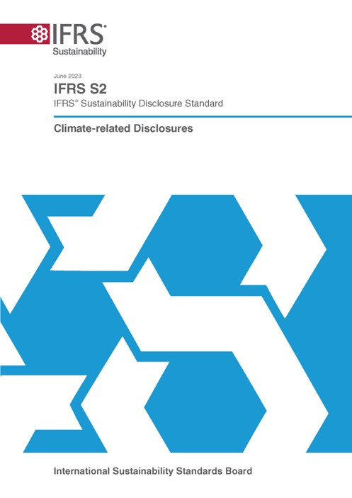
IFRS S2: Climate-related Disclosures
Incorporates the TCFD recommendations
To meet investor information needs, IFRS S2:
is used in accordance with IFRS S1
requires disclosure of material information about climate-related risks and opportunities, including physical and transition risks
requires industry-specific disclosures, which are supported by accompanying guidance built on SASB Standards
Notes:
IFRS S2 fully incorporates the TCFD recommendations, requiring companies to disclose information about climate-related risks and opportunities, building on the requirements in IFRS S1.
This includes cross-industry and industry-specific information necessary for investors to understand the impact of climate on a company's performance and prospects.
Climate-related risks include both physical risks, such as those resulting from increased severity of extreme weather and transition risks, such as those associated with policy action and changes in technology that can affect how a company can run its business.
Climate-related opportunities refers to the potential positive effects arising from climate change for a company.

Slide 19
Material climate-related information enables investors to:
Material climate-related information enables investors to:
Determine the effects of climate-related risks and opportunities on the company’s performance and prospects
Understand the company’s response to, and strategy for, managing its climate-related risks and opportunities, including its climate-related transition planning
Evaluate the ability of the company to adapt its planning, business model and operations to climate-related risks and opportunities
Understand climate-related risks and opportunities in a company’s value chain
Notes:
In applying IFRS S2, a company identifies and discloses material information about climate-related risks and opportunities. IFRS S1 helps companies work out how to do this.
Investors need this information to understand how climate affects a company’s performance and prospects, including its response to - and strategy for managing - its climate-related risks and opportunities. This in turn includes its transition planning.
Investors also use this information to evaluate the ability of the company to adapt its planning, business model and operations to climate-related risks and opportunities and to understand how climate risks manifest in its value chain.

Slide 20
IFRS S2 needs to be applied with IFRS S1
IFRS S1:
establishes key concepts such as connected information, value chains, and which sustainability- and climate-related risks and opportunities to report on
provides vital guidance on the assessment of materiality
sets out the qualitative characteristics of the information to be provided, eg that it needs to be relevant and represented faithfully
sets out requirements for reporting, such as:
the reporting entity
timing and location of reporting
connections and comparatives in reporting
sets out how to deal with changes in estimates and errors, disclosures on judgements, assumptions and estimates, requirements on when to aggregate and disaggregate information, focussed exemptions from disclosing commercially sensitive opportunities, and the interaction with law and regulation
Notes:
IFRS S2 is required to be used with IFRS S1. This is because IFRS S1 sets out the way companies should approach reporting.
For example, IFRS S1 establishes the key concepts, such as the need for connected information and how to think about the value chain.
IFRS S1 provides important guidance on the assessment of materiality to be used when applying IFRS S2, which determines which particular disclosures a company needs to apply given its own circumstances.
IFRS S1 sets out the qualitative characteristics of the information that has to be provided - for example that information needs to be relevant and representationally faithful.
IFRS S1 also sets out the requirements about the reporting that has to be provided, such as that it needs to be provided at the same time as the financial statements and in the general purpose financial report with the financial statements.
IFRS S1 also explains how to deal with things like changes in estimates and errors, provides relief from providing commercially sensitive information about opportunities and indicates when to disaggregate or aggregate information.
So, for any of those aspects of reporting about climate, an entity needs to use IFRS S1.

Slide 21
Key disclosures
Strategy
Metrics and targets
Strategy and decision-making
Scope 1-3 GHG emissions
Current and anticipated financial effects
Industry-based disclosures
Climate resilience
Climate-related targets
Notes:
As in IFRS S1, IFRS S2 requires a company to disclose information about its governance, strategy and risk management, as well as metrics and targets, but this time specifically in relation to its climate‑related risks and opportunities.
In IFRS S2 some of the key requirements are found within strategy, and metrics and targets, including climate targets and how climate-related risks and opportunities influence a company’s strategy and decision-making.
Companies must disclose their responses to these risks and opportunities, including changes in business models and plans to transition to a lower-carbon economy.
Companies are also required to disclose the current and anticipated effects of climate-related risks and opportunities on their financial performance, financial position and cash flows.
They are also asked for an assessment of their climate resilience, using climate-related scenarios.
Finally, IFRS S2 asks that information be provided about climate targets that a company has set – such as its greenhouse gas emissions targets and how it plans to achieve them.
This includes disclosure of a company’s Scope 1, 2 and 3 GHG emissions, for which IFRS S2 provides associated guidance.
IFRS S2 also requires industry-based metrics that are associated with common business models and activities in a particular industry, as well as disclosure of any climate-related targets the company has set or is required to set by law or regulation.

Slide 22
Climate resilience
Climate resilience
The resilience of a company’s strategy and business model to climate-related changes, developments and uncertainties
Inputs and key assumptions used in the scenario analysis
Climate resilience assessment
Notes:
Climate change - and the uncertainties associated with it - can affect the resilience of a company’s strategy and business model.
To help investors understand its climate resilience, IFRS S2 requires a company to disclose information about the implications of climate change for its strategy and business model, and its financial and operational capacity to adjust or adapt over the short, medium and long term.​
​All companies are required to use climate‑related scenario analysis to inform their disclosures about their resilience to climate change.
IFRS S2 does not specify which scenarios a company should use in its analysis, but it does require the company to use relevant scenarios and provide information about the scenarios it has selected. It also requires the company to provide information about other relevant assumptions it has used in the scenario analysis.

Slide 23
Climate resilience: scenario analysis
Companies need to use climate-related scenario analysis when reporting on climate resilience
IFRS S2 includes application guidance on how to apply scenario analysis
Building on TCFD materials
The guidance requires:
a method of climate-related scenario analysis commensurate with a company’s circumstances
the use of all reasonable and supportable information that is available to a company at the reporting date without undue cost or effort
Notes:
IFRS S2 contains guidance to ensure the requirement to undertake scenario analysis to support resilience disclosures is proportionate.
This includes guidance on how a company is required to determine its approach to such scenario analysis.
Climate-related scenario analysis encompasses a range of practice, from qualitative scenario narratives to complex statistical modelling. Considering this, the ISSB decided to require a company to use an approach that is commensurate with the company’s circumstances. It also requires the company to use all reasonable and supportable information that is available to it at the reporting date without undue cost or effort.
To determine what approach is commensurate with its circumstances, the company is required to consider both its exposure to climate-related risks and opportunities – the greater the exposure, the greater the need for a sophisticated scenario analysis – and its skills, capabilities and resources available for the climate-related scenario analysis.

Slide 24
GHG emissions
GHG emissions
Disclose a company’s absolute gross Scope 1, Scope 2 and Scope 3 GHG emissions
Scope 1: direct emissions
Scope 2: indirect emissions from the generation of purchased energy consumed by the company
Scope 3: other indirect emissions that occur in the company’s value chain
Disclosure of how and why a company has used specific inputs, assumptions and estimation techniques to measure its GHG emissions, including any changes to these
Measured in accordance with the GHG Protocol Corporate Standard
Notes:
IFRS S2 requires a company to disclose its absolute Scope 1, Scope 2 and Scope 3 greenhouse gas emissions.
In other words, the Standard requires companies to disclose their direct and indirect emissions. The emissions must be measured in accordance with the GHG Protocol Corporate Standard unless a jurisdiction requires a company to use a different approach to measurement.
Not all companies currently measure their emissions using the GHG Protocol Corporate Standard. If a company is using a different measurement method, it is permitted to use that method in its first year of applying IFRS S2. This is intended to assist companies when starting to use the Standards.

Slide 25
Industry-specific requirements
Industry-specific disclosure is useful because:
relevant sustainability-related issues vary by industry
investors analyse companies and portfolios by industry and sector
companies can focus on reporting that more closely fits their business
it reduces costs and minimise noise by focusing on the most relevant information
IFRS S2:
requires that industry-specific disclosures be provided. The industry-based metrics provided are illustrative guidance rather than requirements
an exception to this is information about financed emissions which is required to be provided
Notes:
Industry-specific disclosure is useful because relevant sustainability-related issues vary by industry; because investors analyse companies and portfolios by industry and sector; because companies can focus on reporting that more closely fits their business; and because it reduces costs and minimises noise by focusing on the most relevant information.
IFRS S2 requires companies to make industry-specific disclosures relevant to their business models and activities.
To provide these disclosures, companies are required to refer to - and consider disclosure topics and associated industry-based metrics in - the Industry-based Guidance on Implementing IFRS S2.
This guidance is based on the SASB Standards, with modifications to enhance their international applicability.
Disclosure topics identified in this guidance represent the climate-related risks and opportunities most likely to affect companies in a particular industry, and the associated metrics that are most likely to result in the disclosure of material information.

Slide 26
Mechanisms that support application
Use of well-known terminology and concepts
Proportionate:
the instruction to use reasonable and supportable information available without undue cost or effort
consideration of skills, capabilities and resources
Help through:
guidance within the Standards and educational materials
sources of guidance to identify sustainability-related risks and opportunities, and metrics
other clarifications, such as permitting qualitative scenario analysis and qualitative information on financial effects
Transitional reliefs
Notes:
The ISSB has sought to achieve a balance between the costs for companies in applying the requirements and ensuring investors are provided with consistent, comparable and verifiable information.
The ISSB has used mechanisms to support application which help to facilitate this.
Where possible, the ISSB has used terminology and concepts that should be familiar to report preparers.
The ISSB designed many requirements in IFRS S1 and IFRS S2 to be applied in a manner appropriate for a company’s circumstances—that is, the requirements are ‘proportionate’ to the range of capabilities and preparedness of companies around the world.
The Standards also include guidance to help companies understand how to apply the Standards and refer to sources of guidance to assist companies in reporting on topics beyond climate.
The Standards also allow for temporary or permanent relief from some requirements, depending on a company’s circumstances.
For example, a company may provide qualitative rather than quantitative information about the anticipated financial effects of a sustainability-related risk or opportunity if it does not have the skills, capabilities or resources to provide quantitative information.
The ISSB has also included transitional reliefs, which I’ll come onto next.

Slide 27
Reliefs for first year of application
can limit disclosures to climate-related information
later reporting allowed - annual information can be provided with half year reporting
Scope 3 disclosure not required
do not need to apply Greenhouse Gas Protocol if already using a different measurement approach
do not need to provide comparative information*
*companies that limit disclosures to climate-related information in the first year do not need to provide comparative information about their sustainability-related risks and opportunities beyond climate in their second year.
Notes:
To help companies transition to reporting under IFRS S1 and IFRS S2, the ISSB provides reliefs for the first year of application.
These include that companies can limit disclosures to climate-related risks and opportunities and begin reporting on their other sustainability-related risks and opportunities in the second year they apply IFRS S1 and IFRS S2.
The reliefs also include that companies can provide annual sustainability-related financial disclosures with their next half-year reporting, rather than at the same time as the financial statements.
In the first year, companies also do not need to provide disclosures about Scope 3 GHG emissions, or apply the GHG Protocol Corporate Standard to measure emissions if they are already using a different measurement approach. Nor do they need to provide comparative information.
Companies that limit disclosures to climate-related information in the first year also do not need to provide comparative information about their sustainability-related risks and opportunities beyond climate in their second year.
These reliefs are designed to give companies time to put in place reporting practices and structures to provide high-quality, decision-useful information.

Slide 28
Assurability
It is important that investors can be confident about the robustness of the information provided when companies use ISSB Standards
The Standards have been designed so that information provided can be assured, for example, through:
use of reasonable and supportable information
disclosures about the use of judgements, assumptions and estimates
The ISSB is in dialogue with the International Auditing and Assurance Standards Board (IAASB), who develops Auditing and Assurance Standards.​
Notes:
The key objective of the ISSB is to facilitate the provision of relevant information about sustainability-related risks and opportunities to investors that they can rely on to make investment decisions. ​
When information is subject to assurance, it increases investor confidence that they can rely on the information provided.​
The ISSB is not responsible for deciding whether reports are subject to assurance. That is a decision made by jurisdictions and regulators.​
However, to ensure that information can be relied upon, the ISSB Standards have been written in a way that supports assurance and verifiability of information.​
The ISSB is in dialogue with the International Auditing and Assurance Standards Board, or IAASB. Both bodies recognise that current practices need to evolve to deliver assurance on ISSB-based disclosure. ​The IAASB is developing an overarching standard for assurance on sustainability reporting.​

Slide 29
Supporting the global baseline through tagging
Like the ISSB Standards, the ISSB Taxonomy is designed to be used as a global baseline and enable jurisdictions to build on that global baseline—facilitating digital comparability
The ISSB Taxonomy:
Can be directly used by a jurisdiction that adopts the ISSB Standards
Can be built on to accommodate additional jurisdictional requirements by a jurisdiction that builds on the ISSB Standards
If necessary, can support the interoperability of the ISSB Standards with other sustainability standards—enabling common information to be identified so that investors can clearly identify the global baseline
Notes:
The ISSB’s objective with its Standards is to provide a global baseline of information that is comparable across markets. That objective is achieved from a regulatory perspective when jurisdictions choose to use the ISSB Standards.
The ISSB Taxonomy is available for use in the same way. The objective is to support jurisdictions to reap the full benefit of using ISSB Standards by facilitating the global comparability of digital sustainability-related financial disclosures prepared in accordance with the ISSB Standards.
A jurisdiction that adopts the Standards can directly use the ISSB Taxonomy. A jurisdiction that adopts and builds additional disclosure requirements on top of the ISSB Standards can also build on the Taxonomy to accommodate those additional disclosure requirements. So, it’s really designed to support the global baseline.
In developing the Taxonomy, the ISSB has also thought hard about interoperability with other taxonomies when that is necessary – for example in the case of Europe. The ISSB intends digital taxonomies to work in a way that really supports interoperability between the ISSB and European Sustainability Reporting Standards, including to enable investors to clearly identify the ISSB’s global baseline.

Slide 30
Achieving efficient reporting through interoperability
Ongoing dialogue with jurisdictions to ensure consistency across reporting requirements, eg the European Commission
ISSB Standards mark “culmination of the work of the TCFD”
CDP has aligned its platform to IFRS S2
Work with GRI to deliver full interoperability
Notes:
The ISSB is developing its Standards to facilitate compatibility with requirements and standards jurisdictions have in addition to the ISSB’s global baseline – such as those that are jurisdiction-specific or aimed at a wider group of stakeholders.
In this regard, the work that the ISSB is doing with jurisdictions is critical.
The ISSB has a jurisdictional working group comprised of representatives from jurisdictions including China, Europe, Japan, the UK and the US, as well as IOSCO as observers. This group is working to ensure that the global baseline meets investors’ needs and has good interoperability, thereby reducing duplication and improving efficiency of the reporting system.
The ISSB also has a Sustainability Standards Advisory Forum comprised of members from jurisdictions around the world. It holds regular bilateral engagements to ensure what the ISSB is developing is truly global.
The ISSB also works with key partners in the disclosure landscape. For example, the ISSB’s Standards marked the culmination of the work of the TCFD, which has now disbanded as a result.
CDP is the ISSB’s key global climate disclosure partner providing a trusted tool that supports companies on their path to compliance with ISSB Standards. CDP’s questionnaire is aligned with IFRS S2 as the foundational baseline for CDP’s climate disclosure.
Finally, the ISSB and GRI’s Global Sustainability Standards Board have committed to jointly identify and align common disclosures that address information needs under the distinct scopes and purposes of their respective standards, for both thematic and sector-based standard setting. This collaboration seeks to provide a seamless, global and comprehensive sustainability reporting system for companies looking to meet the information needs of both investors and a broader range of stakeholders.

Slide 31
High degree of alignment in climate-related disclosures*
ESRS:
Additional requirements for stakeholders interested in impacts (that do not create risks or opportunities for a company’s prospects) and information that if missing or obscured is not reasonably expected to affect investor decisions
ISSB Standards:
Additional requirements (eg financed emissions)
High-degree of alignment in disclosures to provide decision-useful information for investors on risk management and how dependencies and impacts create risks and opportunities for a company’s financial position and prospects
* IFRS Foundation and EFRAG have published interoperability guidance material: https://www.ifrs.org/content/dam/ifrs/supporting-implementation/issb-standards/esrs-issb-standards-interoperability-guidance.pdf
Notes:
Many companies around the world will be required – or choose – to apply both the ISSB Standards and the European Sustainability Reporting Standards, or ESRS.
There is a high degree of alignment between ISSB Standards and the ESRS around climate-related disclosures, with both aiming to provide decision-useful information to investors. While the ISSB has additional requirements for investor-focused disclosures, the ESRS includes additional requirements for stakeholders interested in broader impacts.
The IFRS Foundation and European Financial Reporting Advisory Group, or EFRAG, have published guidance material to illustrate this high level of alignment achieved between the ISSB Standards and the ESRS.
The guidance also shows how a company can apply both sets of standards, including detailed analysis of the alignment in climate-related disclosures.

Slide 32
The ISSB Standards can deliver
TheSB Standards can deliver
For investors: access to more consistent, comparable, verifiable and comprehensive disclosures.
For companies: positive effects on areas such as governance, strategy, access to capital, cost of capital, reputation, and employee and stakeholder engagement.
For financial markets: improved transparency about sustainability-related risks is expected to contribute to long-term financial stability.
Notes:
So, what are the benefits expected as a result of the implementation of the ISSB Standards.
For investors, the benefits include avoiding costs associated with manual data collection and analysis, improved data quality, and enhanced transparency about sustainability-related risks, so contributing to long-term financial stability.
Many of these benefits for investors stem from the greater consistency, comparability, and verifiability of disclosures when IFRS S1 and IFRS S2 are applied.
For companies, these Standards improve data quality, governance, strategy, and access to capital, while reducing disclosure complexity.
The Standards also facilitate the reduction of fragmented disclosure requirements and reduced complexity for preparers and investors. They encourage companies with less mature disclosure practices to improve, so enhancing the information available to capital markets. They also promote transparent capital markets that better reflect the cost of risk and support transition and adoption efforts.

Slide 33
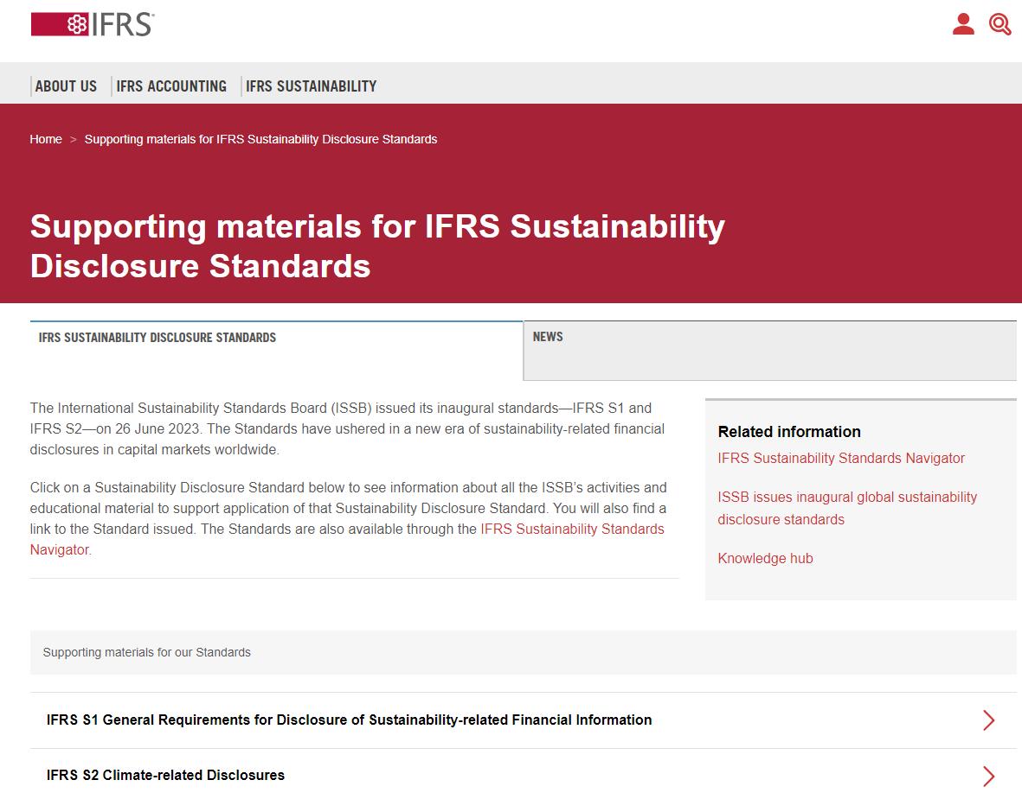
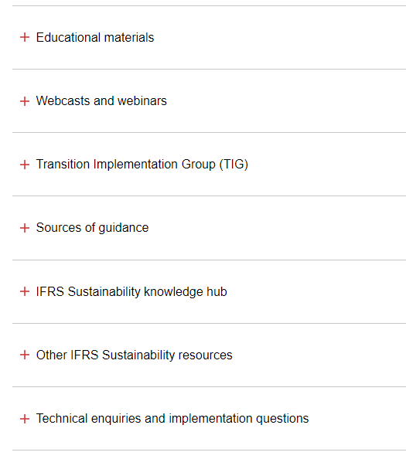
Notes:
So that’s an introduction to the IFRS Foundation and the ISSB Standards. You can learn more via the IFRS Foundation website, including by accessing supporting materials developed to help further understanding.
Here, you will find educational material, including on the link between IFRS S2 and the TCFD recommendations, how to think about the nature and social aspects of climate-related risks and opportunities, interoperability considerations around greenhouse gas emissions when applying GRI Standards and ISSB Standards, materials about the SASB Standards and Integrated Reporting Framework - and more!

Slide 34
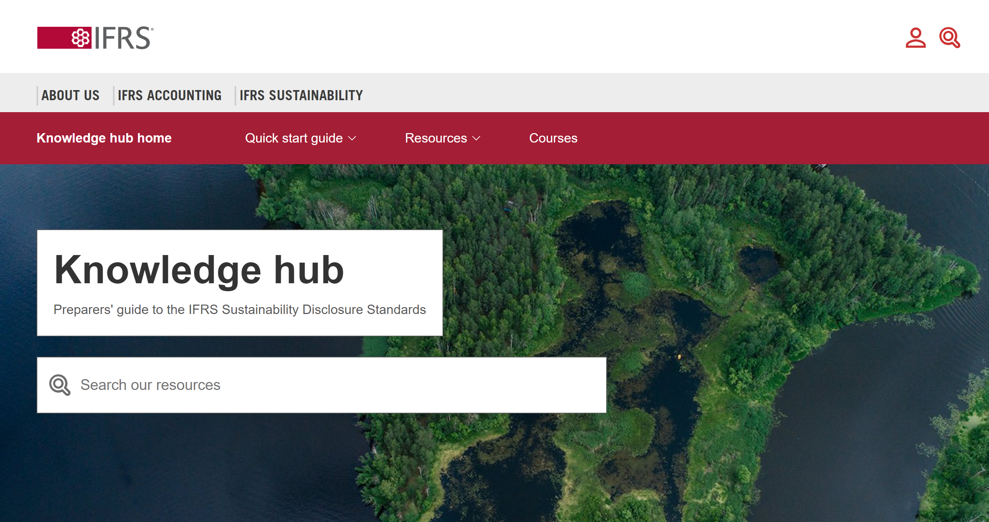
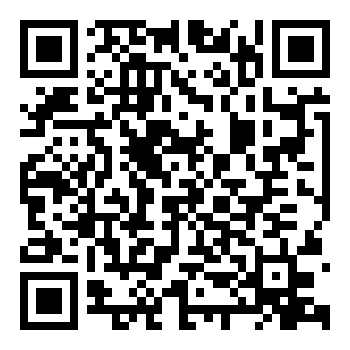
34
Knowledge hub
Supporting the application of IFRS Sustainability Disclosure Standards
FAQs, guides and resources curated by the IFRS Foundation and third-party organisations in support of global drive to build capacity
Notes:
You will also be able to access the IFRS Sustainability Knowledge Hub via the IFRS Foundation website. This hosts information from third parties about sustainability-related disclosures that you might find useful.

Slide 35
ISSB work plan
ISSB work plan H2 2024–H1 2026
Highest level of focus on supporting implementation of IFRS S1 and IFRS S2
Next, equal focus on enhancing SASB Standards and two research and standard-setting projects
Some capacity reserved for flexibility to address emerging issues
Furthermore, three activities fundamental to all work:
interoperability with other standard- setting initiatives
connectivity with IASB
stakeholder engagement
Notes:
To conclude, let’s take a quick look at what the ISSB is currently focused on.
First, the ISSB is focused on supporting the implementation of IFRS S1 and IFRS S2.
Next, it places equal focus on enhancing the SASB Standards and two research and standard setting projects. The first is on biodiversity, ecosystems and ecosystem services. The second is on human capital.
The ISSB has reserved capacity so that it has flexibility to address emerging issues.
Finally, the ISSB has identified three activities that are fundamental to all of its work. These are interoperability with other standard setters, connectivity with the IASB, and stakeholder engagement.

Slide 36
36
Visit ifrs.org to find out more
Access the Standards and supporting materials
Listen to the monthly podcast
Respond to live consultations
Sign up for news alerts
Learn about digital financial reporting resources
Observe ISSB meetings
Notes:
Thank you for listening.
Please visit ifrs.org to find out more.

